Slide 1
Machine learning applications in movement biomechanics
Sina David & Marion Mundt
ISBS Pre-Conference Workshop
Salzburg, 15 July 2024

Slide 2
Agenda
8:30 - 9:30 | Applications of machine learning to support movement biomechanics analysis Basics of machine learning/ statistics
9:30 - 10:00 | Introduction to the data set
15 mins coffee break
10:15 - 12:30 | Hands On Pose estimation Regression
60 mins lunch break
13:30 - 16:00 | Hands On Classification Clustering and Dimensionality reduction
15 mis coffee break
16:15 - 17:00 | Pros and Con of machine learning in biomechanics Challenges and reporting requirements

Slide 3
Machine learning applications in movement biomechanics

Slide 4
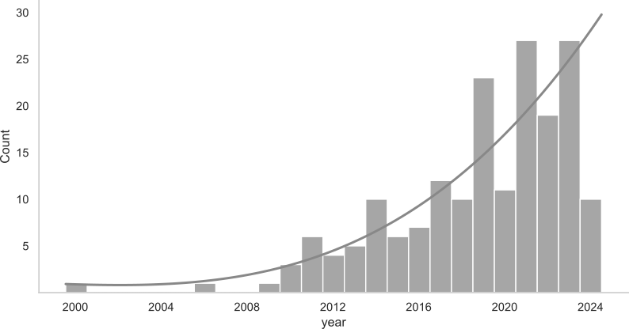
Machine learning In Movement Biomechanics over time

Slide 5
Machine learning Applications in movement Biomechanics
Regression
43%
57%
Classification

Slide 6
Machine learning Applications in movement Biomechanics
Joint kinetics
Joint kinematics
Ground reaction force
25%
Barbell kinematics
Jump height
Fatigue rating
18%
Good vs bad movement execution
Injured vs non-injured athletes
Technique types
57%

Slide 7
Machine learning Applications in movement Biomechanics
Swimming
Athletics
Ski jumping
7%
2%
Gym
4%
18%
69%
Running/side stepping

Slide 8
Basics of machine learning

Slide 9
Basics of machine Learning
Artificial Intelligence
Machine Learning
Deep Learning
Artificial Intelligence
Technique which enables machines to mimic human behavior
Machine Learning
Subset if AI techniques which use statistical methods to enable machines to improve with experience
Deep Learning
Subset of ML which make the computation of multi-layer neural networks feasible

Slide 10
K-NN
SVM
Fuzzy c-Means
Mean shift
Decision Trees
Linear regression
Classification
K-means
Clustering
SOM
Polynomial regression
Regression
Dimension Reduction
t-SNE
supervised Learning
Ridge/ Lasso Regression
Unsupervised Learning
PCA
Machine Learning
Pattern Search
Reinforcement Learning

Slide 11
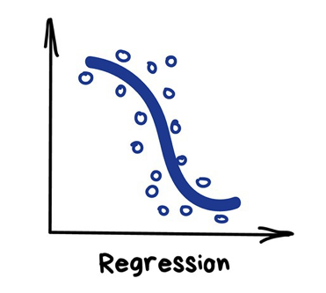
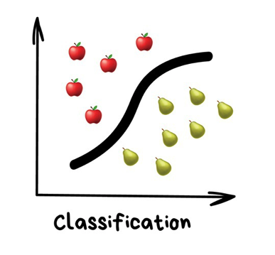
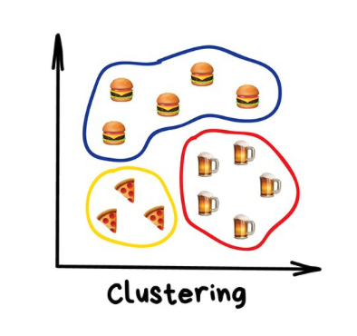
Basics of machine learning
SUPERVISED
UNSUPERVISED
Find a function that best describes the relationship between dependent and independent variable
Find a function that splits inputs based on known attributes
Find a function that splits inputs based on unknown attributes

Slide 12
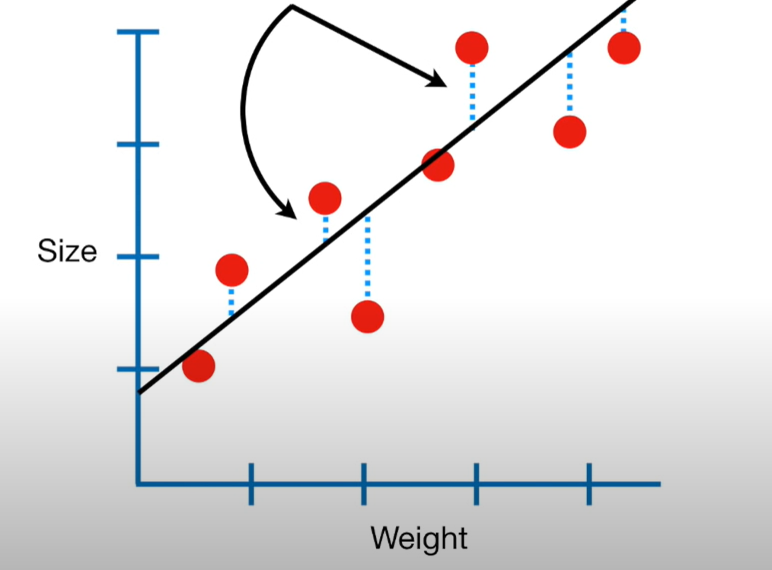
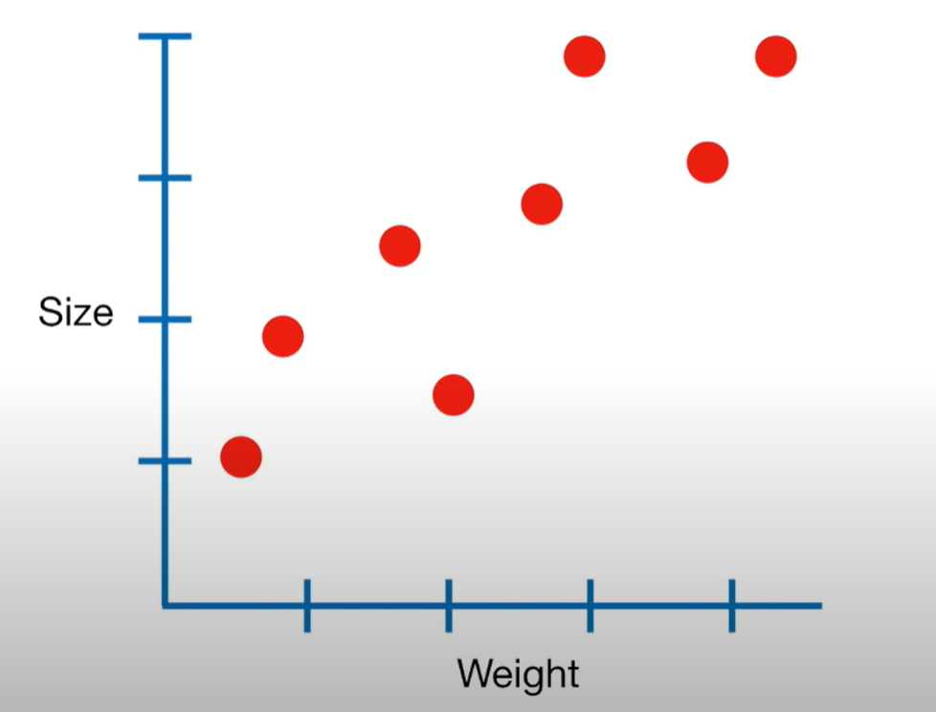
Regression models
Finding the regression line results in the minimum sum of squared residuals
Size = 0.9 + 0.75 x Weight
Intercept
Slope

Slide 13
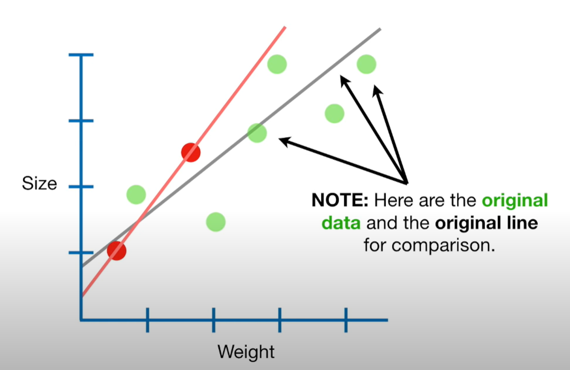
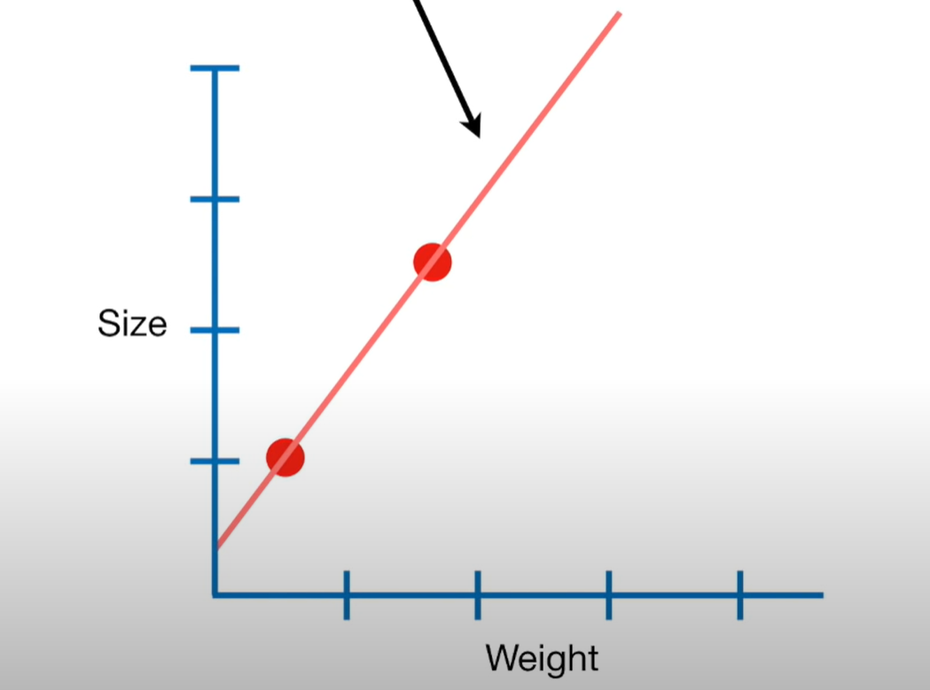
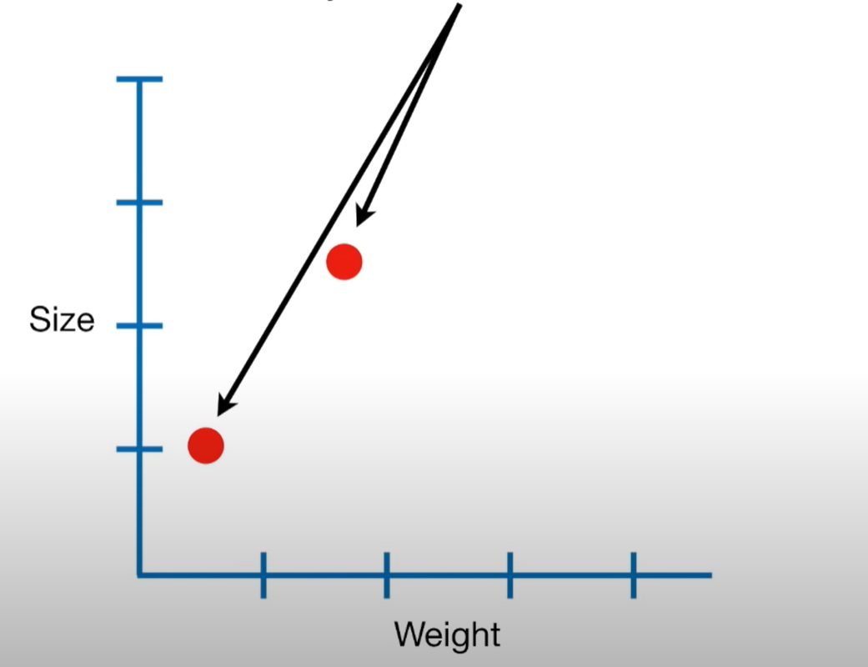
Regression models
Problem: small sample size
New line:
Sum of least squared residuals = 0
Size = 0.4 + 1.3 Weight
Red dots = training data
Sum of least squared residuals = 0
Green dots = testing data
Sum of least squared residuals = large
→ New line is overfit to the testing data

Slide 14
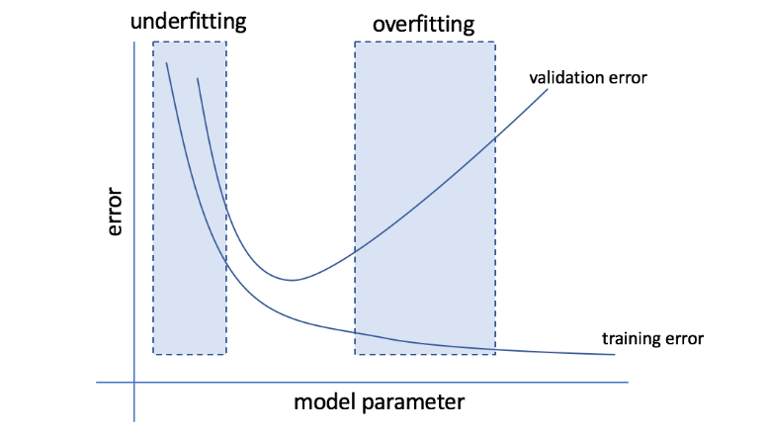
Bias – Variance Trade-off
Bias is reduced and variance is increased in relation to model complexity.
As more and more parameters are added to a model, the complexity of the model rises and variance becomes our primary concern while bias steadily falls.
test error

Slide 15
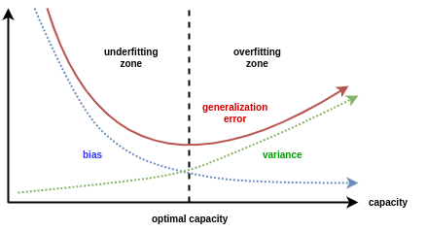
Bias – Variance Trade-off
High bias
High variance
Error
Total error = bias + variance

Slide 16
Model Performance
Evaluate performance of predictive models by assessing how good your model fits the data.
Use metrics that correctly measure how accurate the model is predicting our problem.
We want our model to have the same predictive ability across many different data sets: Results need to be generalizable, comparable, measurable and reproducible.

Slide 17
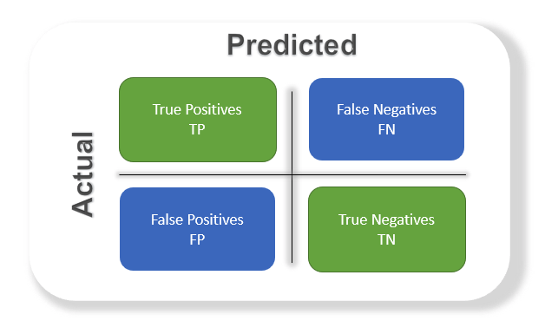
Model Performance
True positives (TP): Predicted positive and are actually positive.
False positives (FP): Predicted positive and are actually negative.
True negatives (TN): Predicted negative and are actually negative.
False negatives (FN): Predicted negative and are actually positive.

Slide 18
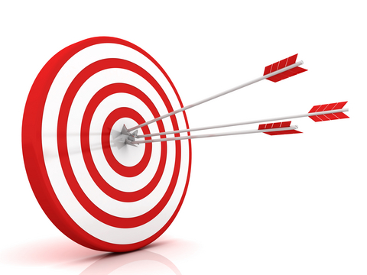
Accuracy
Accuracy is the ratio of number of correct predictions to the total number of input samples.
Accuracy = number of correct predictions
total number of predictions
Accuracy = TP + TN
TP + FP + TN + FN
Caution if data sets are unbalanced!

Slide 19
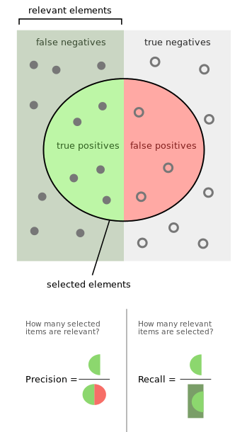
Precision
Precision is the positive predictive value
Precision = number of correct predictions
total number of positive predictions
Precision = TP
TP + FP
How many retrieved items are relevant?

Slide 20
Recall
Recall is the sensitivity or true positive rate.
Recall = number of correct predictions
total number of positives
Recall = TP
TP + FN
How many relevant items are retrieved?

Slide 21
Accuracy-Precision-recall
Accuracy: how often a classification ML model is correct overall?
Precision: how often an ML model is predicting the correct target class?
Recall: can an ML model find all objects of the target class?

Slide 22
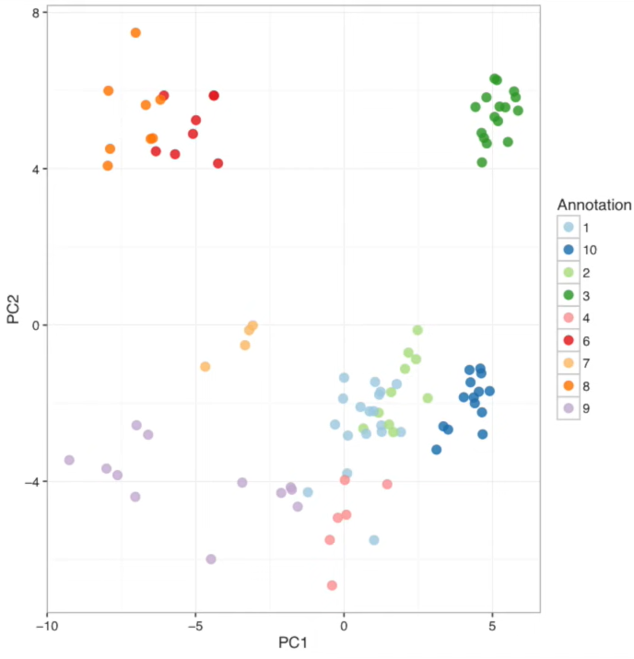
Classification
K-Nearest Neighbors
Step 1: start with a dataset with know attributes.
Step 2: add a new datapoint to the data set.
Step 3: depending on the K, the K-number of closest datapoints are used to define the category of the new data point
→ if K = 1: category = green
→ if K = 7: category = green

Slide 23
Classification
K-Nearest Neighbors
If K = 11, several categories are possible
7 nearest neighbors are red
3 nearest neighbors are orange
1 nearest neighbors is green
→ category = red as it got the most votes
How to choose K?
Split your data set into train and test and test different Ks to find the best one!

Slide 24
Clustering
Number of clusters k = 3
Step 1: determine the number of clusters
Step 2: Randomly select 3 distinct data points (=initial clusters)
Step 3: Measure distance between a randomly selected data point and the 3 initial clusters, do this for all data points.
Step 4: Assign all data points to a cluster according to their distances
Step 5: calculate the mean of each cluster, and repeat Step 3 and 4, now with the distance of the data point to the mean of the cluster.
…continue steps 4 and 5 until there are no changes in the clustering anymore.

Slide 25
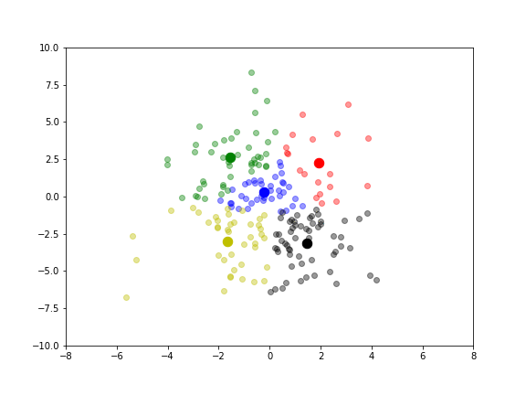
Clustering
K-means clustering
Clustering algorithm in action (changes with each iteration):
Important:
As the starting point initiates the clusters, the whole procedure is repeated with different starting points, the one with the least variation per cluster will be the winner

Slide 26
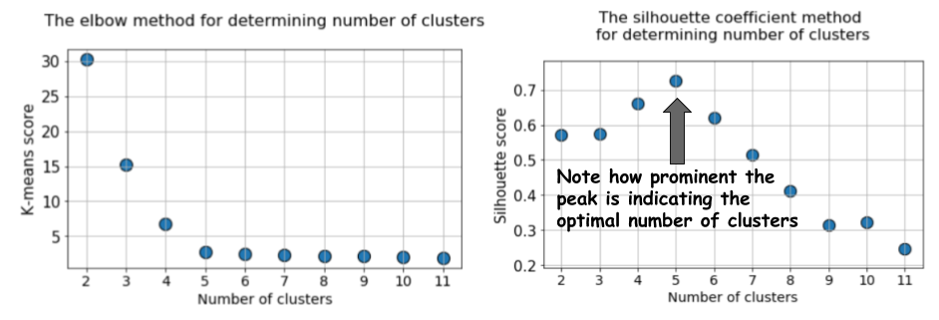
clustering
Considerations for k-means clustering
Estimating the optimal number of clusters (k): scree plot and silhouette coefficient plot

Slide 27
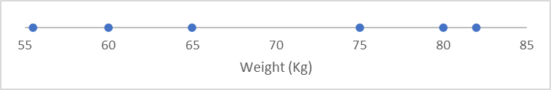
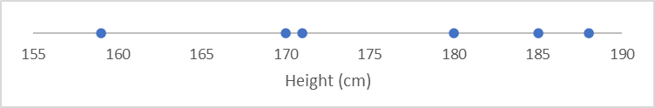
Dimensionality reduction - PCA
 | Athlete 1 | Athlete 2 | Athlete 3 | Athlete 4 | Athlete 5 | Athlete 6
Age | 24 | 23 | 21 | 31 | 30 | 32
Height | 180 | 170 | 185 | 188 | 159 | 171
Weight | 80 | 60 | 82 | 75 | 55.5 | 65

Slide 28
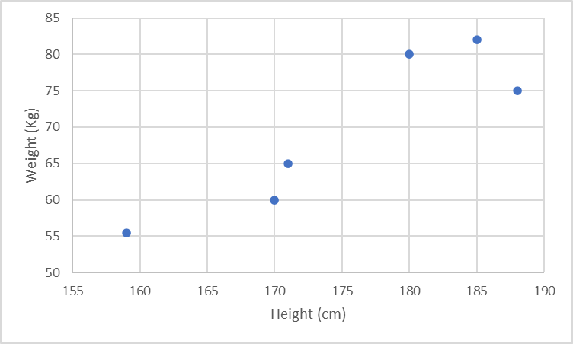
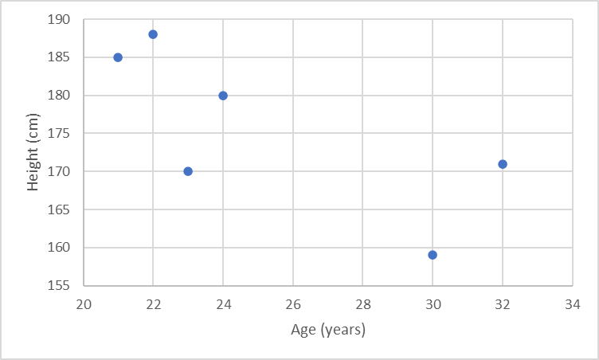
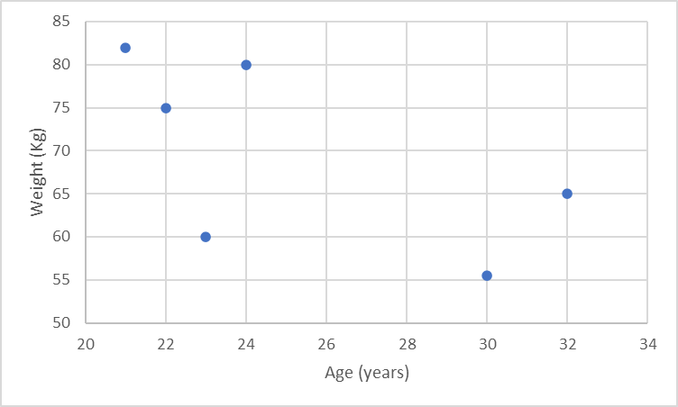
Dimensionality reduction - PCA

Slide 29
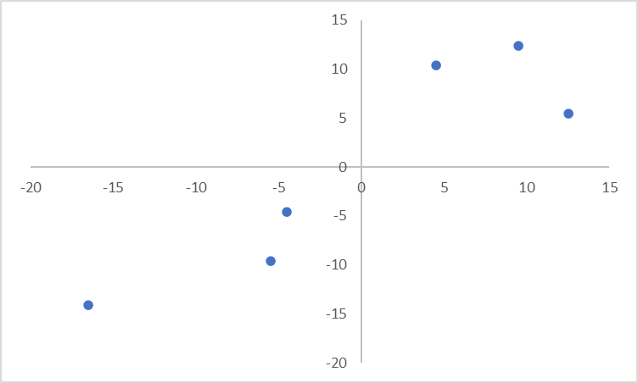
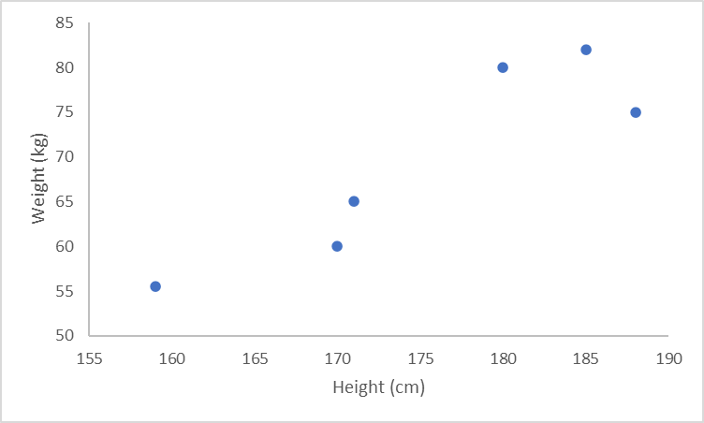
Dimensionality reduction - PCA
Step 1: Calculate the mean of Height and Weight
Determine the center of the data
Step 2: Shift the data so that the center is the origin.
Step 3: Find best-fitting line through origin and data points
Principle component 1 (PC1): slope 0.8
For 1 unit on the Height axis, the Weight changes for 0.8 units.
Most of the variance is explained by PC1
Height is more important to cluster the data than Weight
PC1 is a linear combination of Height and Weight
The Eigenvector of PC1 is the unit vector of the distances to the datapoints
→ The scaled parts of Height and weight are called the loadings of PC1

Slide 30
Dimensionality reduction - PCA
PC2 is perpendicular to PC1
PC2 = -0.8 parts Height, 1 parts Weight
On PC2, Weight is more important than Height
PC3 is perpendicular to PC1 and PC2…
If you have more than two variables, each PC will contain a fraction of all of them.

Slide 31
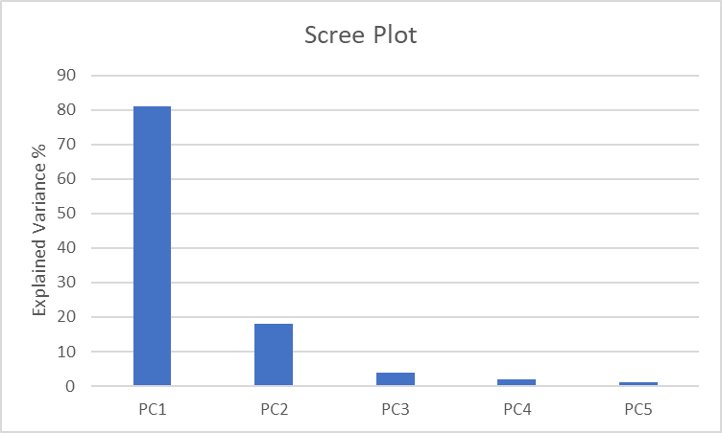
Dimensionality reduction - PCA
The variation around PC1 and PC2 is called Eigenvalue.
If Eigenvalue PC1 = 18 and Eigenvalue PC2 = 4
18/18+4 = 0.81 → PC1 explains 81% of the variance in the data
4/18+4 = 0.18 → PC2 explains 17% of the variance in the data

Slide 32



Dimensionality reduction - PCA
How does PCA help to reduce dimensions?
Assume you have 5 variables, and you want to cluster the data.
The PCA tells you, that PC1 and PC2 account for more than 90% of the variability, so you can cluster directly based on the Eigenscores.
Or take only those variables into account that have the highest loading in PC1 and PC2.
PC1
0.31 Var1
0.08 Var2
0.20 Var3
0.24 Var4
0.17 Var5

Slide 33
Pose estimation

Slide 34
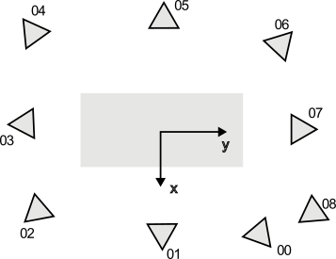
Dataset
15 participants
7 male (1.82±0.11m, 85.7±11.1kg, 27 years)
8 female (1.65±0.08m, 63.2±6.0kg, 25 years)
10 running and 10 walking trials each (running n=149, walking n=149)
full-body marker set (38 individual markers and 8 4-marker clusters)
9 high-definition colour video cameras (200Hz)
Intrinsic and extrinsic camera parameters available
15 optical motion capture cameras (200Hz), 4 force plates (1000Hz)

Slide 35
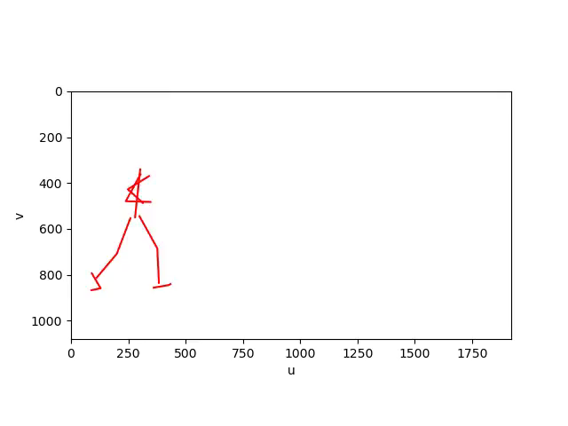
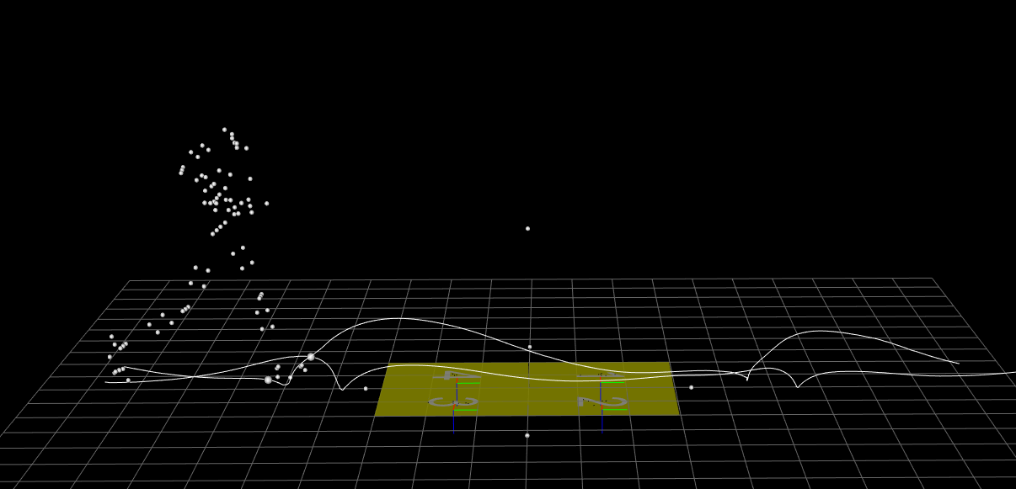
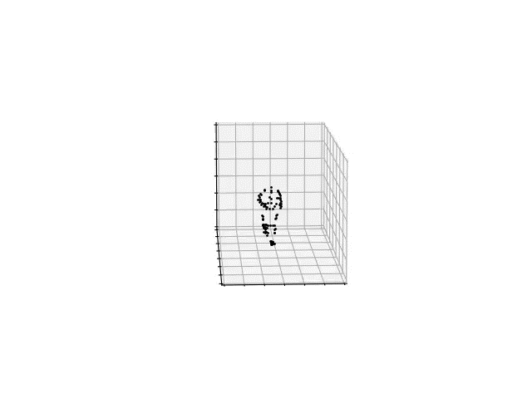
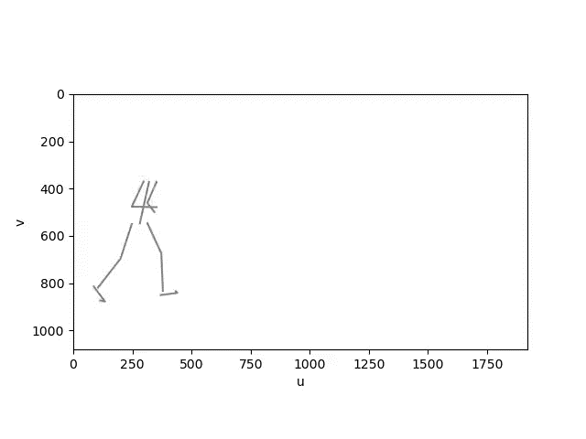
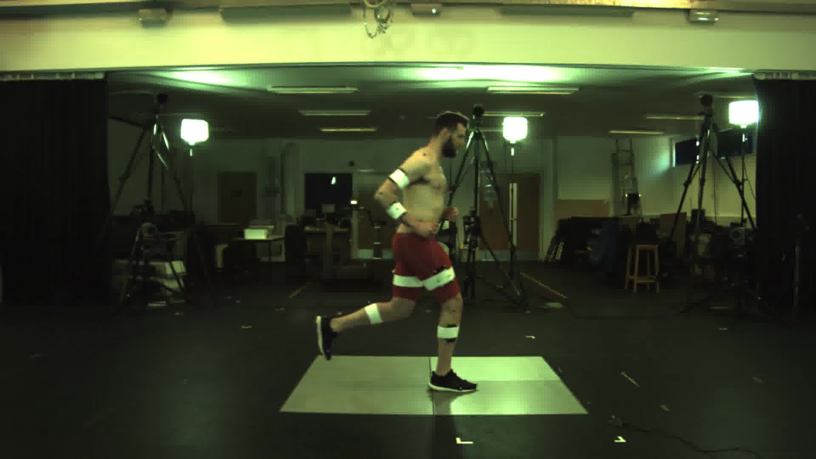
Marker trajectories projected to 2D.
3D marker trajectories → 3D joint centres → 2D joint centres.
OpenPose 2D keypoints.

Slide 36
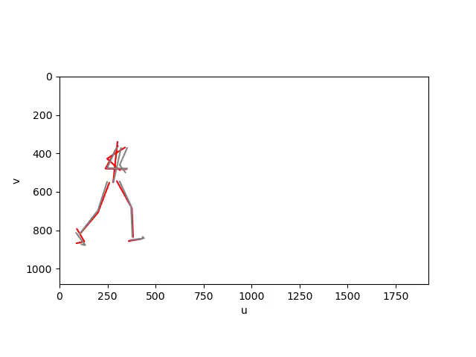
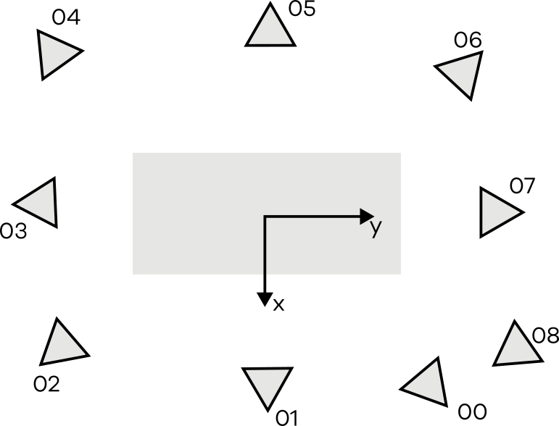
2D pose estimation keypoints and marker derived 2D projections
Notes:
We have OpenPose keypoints, projected keypoints for all nine camera views
Comparison to highlight limitations

Slide 37
Pose estimation considerations
Pose estimation models do usually not include a tracking function, they estimate keypoints frame-by-frame
Especially from a sagittal plane, left and right limbs swap
Pose estimation models mainly rely on large image datasets with keypoints annotated by non-biomechanists
The annotation of two keypoints to define a segment is not sufficient to get information about all 6 degrees-of-freedom in 3D

Slide 38

Dataset
Regression models
Estimation of ground reaction force from marker trajectories
Classification
Classification of running and walking from ground reaction force
Clustering and dimensionality reduction
Notes:
The lower-extremity kinematics and kinetics data of 28 regular runners were collected using a three-dimensional (3D) motion-capture system and an instrumented treadmill while the subjects ran at 2.5 m/s, 3.5 m/s, and 4.5 m/s wearing standard neutral shoes. 12 cameras 48 technical and anatomical reflective markers Clusters with four technical markers, placed in a rigid shell, were used on the thigh and shank segments
42 volunteers, including 24 young adults (age 27.6 4.4 years, .height 171.1 10.5 cm, and mass 68.4 12.2 kg) and 18 older adults (age 62.7 8.0 years, height 161.8 9.5 cm, and mass 66.9 10.1 kg). barefoot conditions overground walking trials, first at a self-selected comfortable speed, and then at speeds 30% faster and 30% slower than the comfortable speed. In addition, the participants walked on the treadmill at eight different controlled speeds, which are described below. Previously, a computerized random-number generator had been used to define the order of the walking trials on the treadmill. The marker-set protocol adopted for this study comprised 26 anatomical reflective markers 1,409 trials (right side: 657; left side: 752) contained a full gait cycle, and 1,233 trials (right side: 685; left side: 548) contained only the stance phase of the gait.

Slide 39
Data set
Running (Fukuchi et al. 2018)
28 participants, neutral running shoes
30s trials of running at 2.5 m/s, 3.5 m/s, and 4.5 m/s
Walking (Fukuchi et al. 2017)
38 participants, barefoot
8 walking speed conditions (1,409 full gait cycles and 1,233 stance phases
Measurement System
12-camera MoCap system
split-belt instrumented treadmill
Notes:
Running 101 trials
Walking 298 trials

Slide 40
Data set
Setup
Walking
Running
Marker data 150 Hz
Ground reaction force 300 Hz
X-axis: anterior – posterior (forward +)
Y-axis: vertical (upwards +)
Z-axis: medio – lateral (right +)
FP1
x
FP2
FP1
x
z
z
Notes:
Running 101 trials
Walking 298 trials

Slide 41
Preparation
Marker trajectories
Extract gap-filled and filtered data
Bilateral pelvis and feet marker
Combine pelvis marker to COM and normalise feet marker to COM
Notes:
Running 101 trials
Walking 298 trials

Slide 42
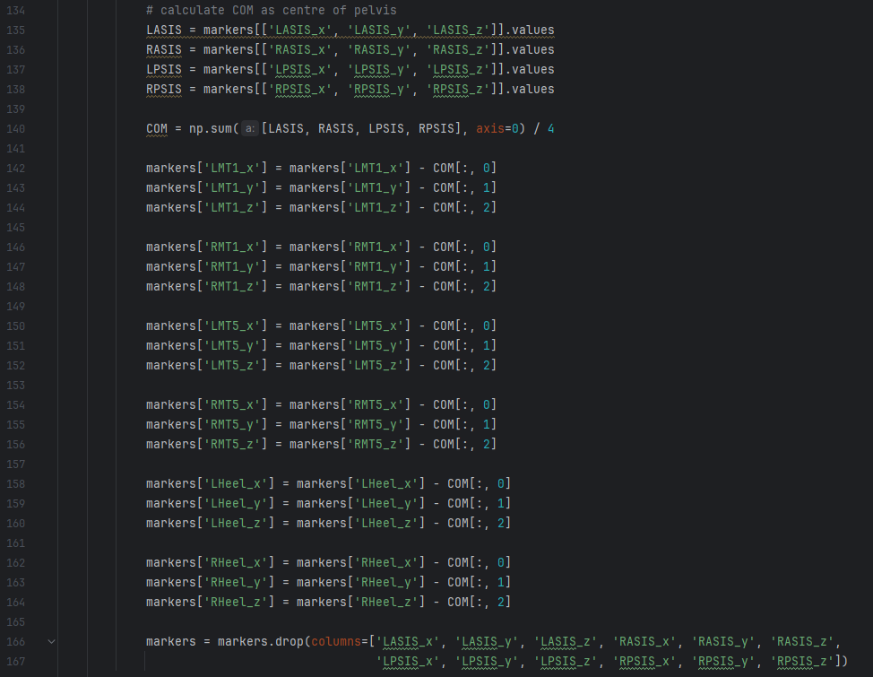
Notes:
Running 101 trials
Walking 298 trials

Slide 43
Preparation
Ground Reaction Force
Walking
Running
Extract filtered data (running 1 force plate, walking 2 force plates)
RUNNING divide into left and right based on position of heel during stance phase
Set all GRF with vertical GRF < 20N to zero
Normalise to each participant’s body weight
FP1
x
FP2
FP1
x
z
z
Notes:
Running 101 trials
Walking 298 trials

Slide 44
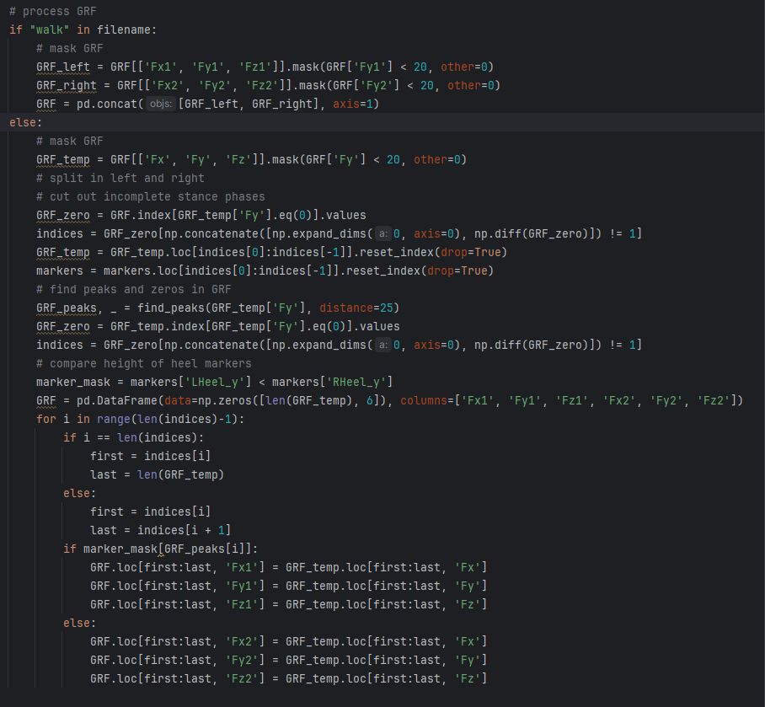
Walking
Running
x
FP1
FP2
x
FP1
z
z
Notes:
Running 101 trials
Walking 298 trials

Slide 45
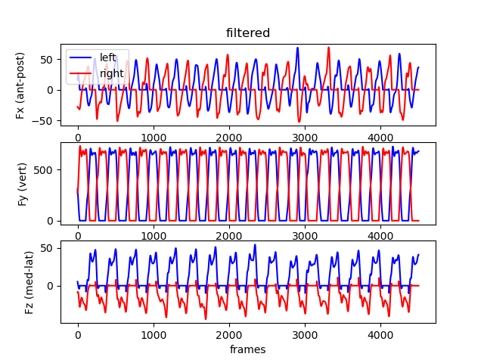
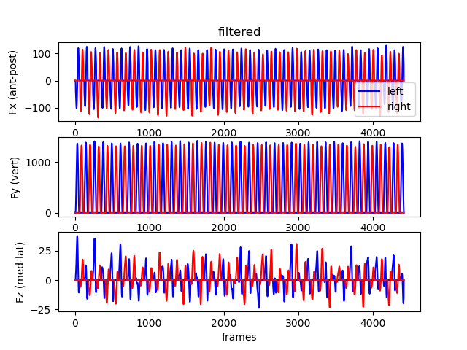
Ground reaction force
Walking
Running

Slide 46
Preparation
RUNNING 86 trials x ~4500 frames x 21 marker / 6 GRF features (28 participants)
WALKING 296 trials x 4500 frames x 21 marker / 6 GRF features (38 participants)
We will use a reduced dataset of 500 frames per trial and only 2 participants for testing!
The network is too small for generalisable results but runs on a CPU in a reasonable time frame.
Notes:
Running 101 trials
Walking 298 trials

Slide 47
Model Training: Regression
Create training/validation/test dataset
Leave-one-subject out
Feature normalisation
Scale features to mean/std of training dataset
Shuffle dataset
Create model
2 bi-directional LSTM layers, 1 dense layer
Loss: mean-squared error
Optimizer: ADAM

Slide 48
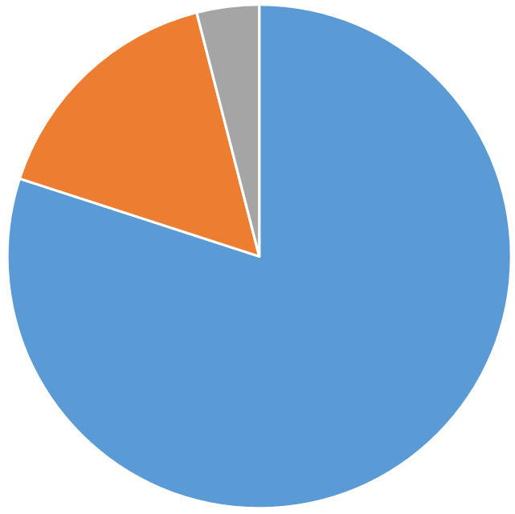
validation
Training data
Used to train the neural network
Validation data
Used to test the performance of the model during training
Testing data
Used to test the performance of the model after training

Slide 49
Cross Validation
iteration 1
accuracy 1
iteration 2
accuracy 2
iteration 3
accuracy 3
iteration 4
accuracy 4
iteration 5
accuracy 5
Final accuracy = average accuracy
IMPORTANT! Split your data set participant-wise!

Slide 50
Feature Scaling, Normalisation and Standardisation
Scale each feature to its range to avoid features with large magnitudes to have increased importance to the ML model. Necessary for optimisation algorithms.
Normalisation:
Min/Max normalisation → not robust to outliers
Standardisation
z-score normalisation (mean and standard deviation) → often preferred over normalisation as it can handle outliers better

Slide 51
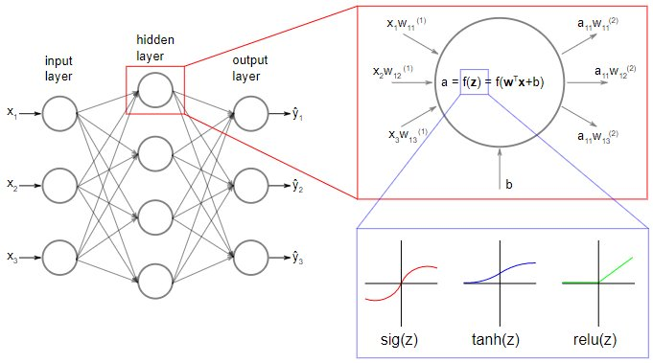
Neural Networks

Slide 52
Architecture and hyperparameters
Architecture:
What kind of layers
How many layers
How many neurons per layer
Activation function
Hyperparameter:
Learning rate
Batch size
No of epochs
Optimiser
Loss function
Evaluation metrics

Slide 53
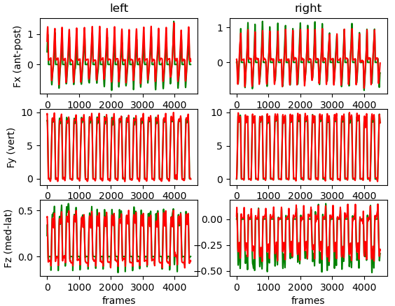
Ground truth vs prediction

Slide 54
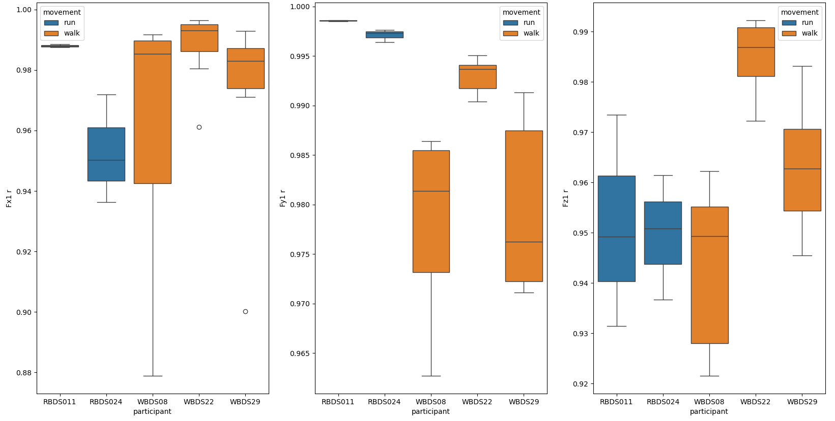
Correlation Coefficient including Zeros

Slide 55
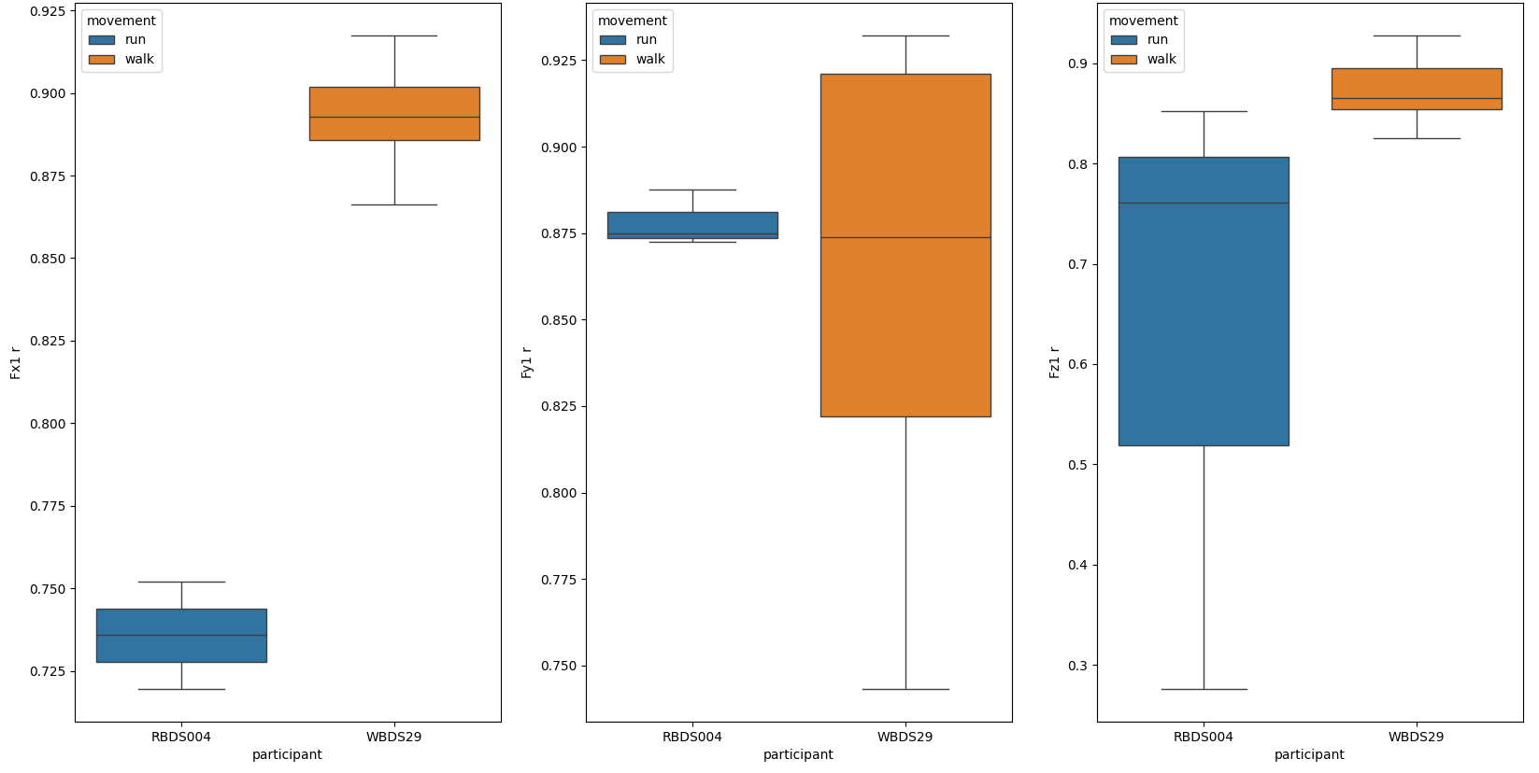
Correlation Coefficient including Zeros

Slide 56
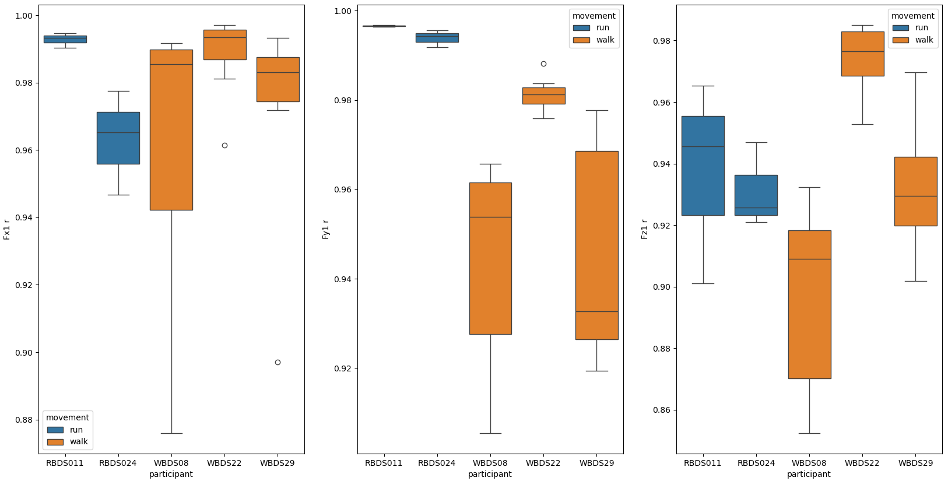
Correlation Coefficient Excluding Zeros

Slide 57
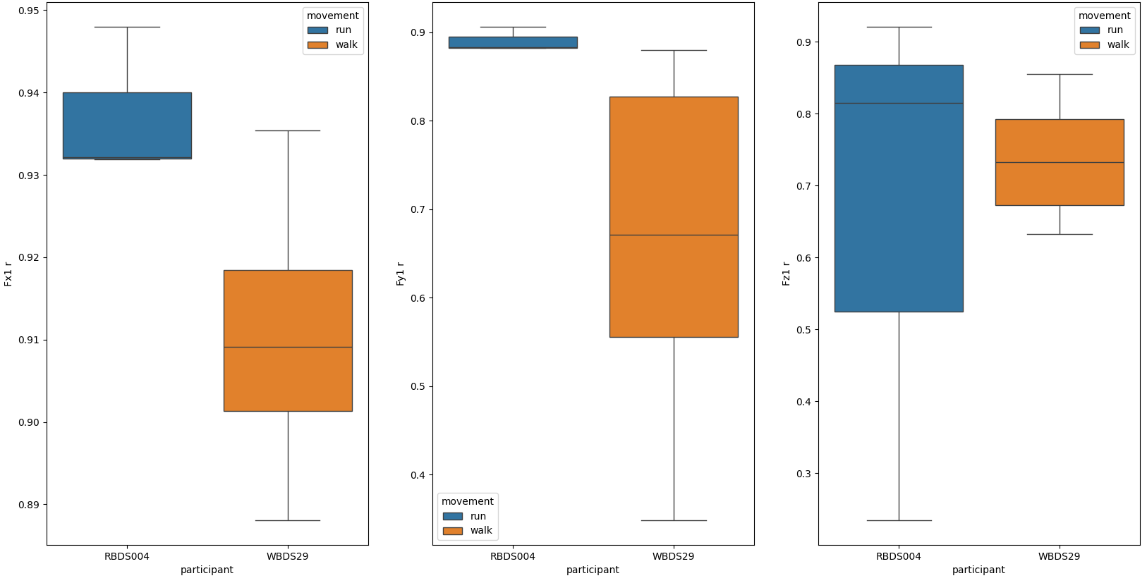
Correlation Coefficient Excluding Zeros

Slide 58
Evaluation
Including Zeros
Excluding zeros
 | RUN |  |  | WALK
 | Fx1 | Fy1 | Fz1 | Fx1 | Fy1 | Fz1
r | 0.74 | 0.88 | 0.63 | 0.89 | 0.86 | 0.87
 | RUN |  |  | WALK
 | Fx1 | Fy1 | Fz1 | Fx1 | Fy1 | Fz1
r | 0.94 | 0.89 | 0.66 | 0.91 | 0.67 | 0.74
The in/exclusion of zeros in the evaluation changes the results.

Slide 59
Evaluation
Including Zeros
Excluding zeros
 | Fx1 | Fy1 | Fz1 | Fx2 | Fy2 | Fy3
r | 0.97 | 0.99 | 0.96 | 0.98 | 0.99 | 0.93
RMSE | 0.16 | 0.70 | 0.09 | 0.14 | 0.68 | 0.10
nRMSE | 0.05 | 0.06 | 0.07 | 0.04 | 0.05 | 0.08
 | Fx1 | Fy1 | Fz1 | Fx2 | Fy2 | Fy3
r | 0.97 | 0.97 | 0.93 | 0.98 | 0.97 | 0.90
RMSE | 0.21 | 0.89 | 0.11 | 0.17 | 0.85 | 0.13
nRMSE | 0.06 | 0.07 | 0.09 | 0.05 | 0.07 | 0.11
The inclusion of zeros in the evaluation improves the results.

Slide 60
Model Training: Classification
Create training/validation/test dataset
Leave-one-subject out
Create binary output features (running 1, walking 0)
Feature normalisation
Scale input features to mean/std of training dataset
Shuffle dataset
Create model
2 bi-directional LSTM layers, 1 dense layer (sigmoid activation)
Loss: binary-crossentropy
Optimizer: ADAM

Slide 61
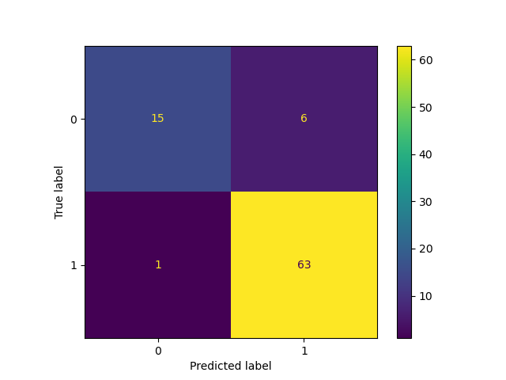
Accuracy: 0.92
Precision: 0.71
Recall: 0.94

Slide 62
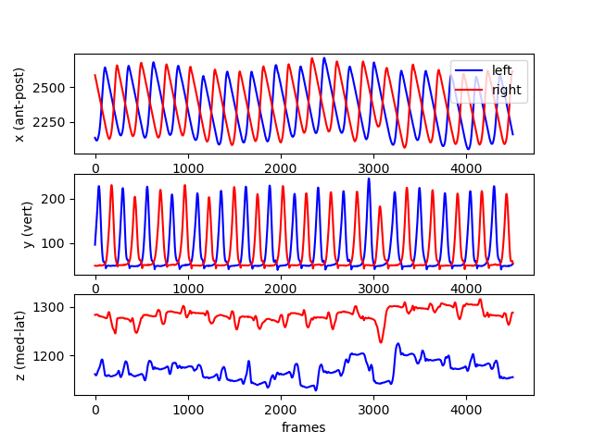
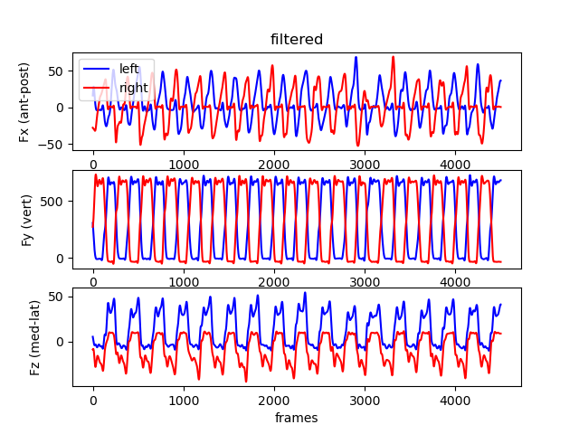
Classify running and walking from GRF

Slide 63
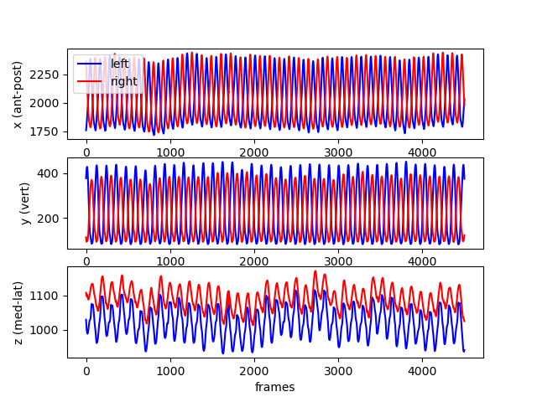
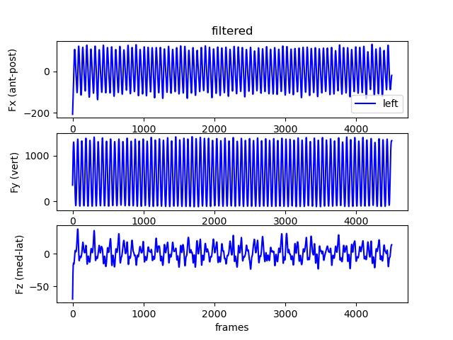
Classify running and walking from GRF

Slide 64
dimensionality Reduction and Clustering

Slide 65
dimensionality Reduction and Clustering
Kohonen self-organizing Maps (SOM)
The network distributes the weights of the Neurons through iterative learning to reach an approximated distribution
The Neurons are organized on a Map that can also be used to illustrate the results
Input data is untagged
No assumptions for the weights of neurons are made

Slide 66
Input Vector
Weights are initialized with first 2 PCs.
Random vector X is chosen from input data.
Euclidean distance (ε) to all neurons is estimated. Neuron with the shortest ε is the winner neuron.
Weight vector W is adapted and will ‚move‘ closer to vector X. As all the weight vectors are connected, this adaptation will also affect the neighbors. ...
End of learning: no more significant change of weigth vectors.
X2
Input layer
X
Neurons
Kohonen layer
W_{new}
W_{old}
X1

Slide 67
Preparation
RUNNING 28 trials x 6 running cycles normalized to 100% x 6 marker (28 participants)
WALKING 114 trials x 6 gait cycles normalized to 100% x 6 marker (38 participants)

Slide 68
Model Training: SOM
Create training / test dataset
Feature normalization/standardization
z-score normalisation (mean and standard deviation), ‘var’→ variable-wise
Train model:
lattice: 'hexa'
shape: 'sheet'
training: 'long’
Best-matching unites (BMUS):
‘best’ → less computations, network will be less smooth

Slide 69
Architecture and hyperparameters
Architecture:
How many neurons → determined by fist two PCs
Which initialization algorithm → linear initialization
Hyperparameter:
Training length: long
Which training sequence: batch
Neighbourhood function: gaussian

Slide 70
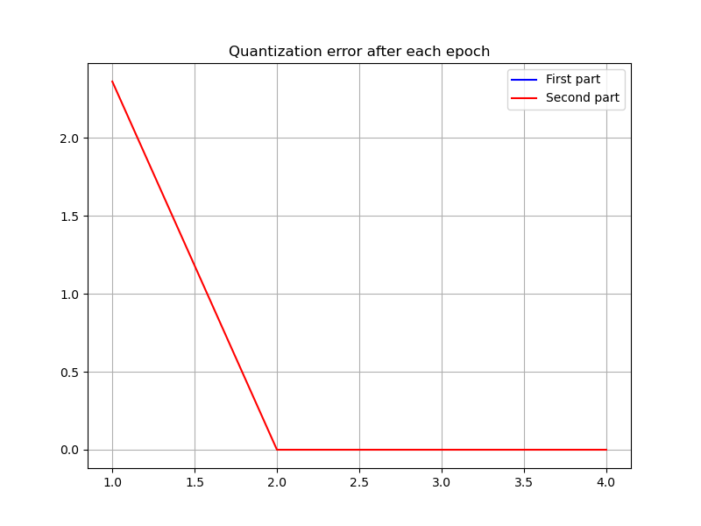







Training

Slide 71




Training – inspecting the Network
Input
3D marker trajectories
Network
Kohonen Self-organizing Map (SOM)
Training
Testing

Slide 72


Results & Discussion MDP

Slide 73
Movement Deviation Profile (MDP)
Movement Deviation Profile (MDP)
MDP: Represents the distance of each running pattern to the gait Data
Training
Gait data
[69084 x 18]
SOM represents Gait Data
Testing
Gait data
[69084 x 18]
Running data
[16968 x 18]
MDP

Slide 74


De-/Normalization?

Slide 75

De-/Normalization?

Slide 76

De-/Normalization?

Slide 77

Results & Discussion MDP
Euclidean Distance between gait and running
Notes:
This image shows the result of this process. The black line represents the mean and standard deviation of the norm data from a straight line, and the green line is representing the stroke data. The distance between the two lines is the Euclidean distance between the stroke and the normal gait patterns. You could also do this individually for each patient to monitor the rehabilitation process.
This workflow shows that the SOM automaticcaly identifies pathologic gait pattern and also can quantify the difference between pathologic and normal gait.

Slide 78

Clustering
Gait and Running have different trajectories along the network
The quantization error creates an additional distance to support clustering

Slide 79
Discussion

Slide 80
Reporting
Be transparent:
Data cleaning, excluded data
Data split
Hyperparameter
Ideally: publish your trained model and code with the paper!

Slide 81

Special thanks to

